Slide 1
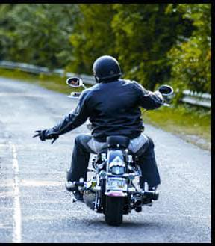
Consequences while riding 2 wheeler leaving one hands
- Left Hand
Synkentrono Software Solutions Private Limited
Authored by : Girish G. Hiremath

Slide 2
Leaving left hand while riding
No balance of handle and vehicle.
All the buttons like, headlight, high beam, low, indicator, horn cannot be turned on.
If it’s a geared bike it is difficult to put a gear. Since no clutch involvement while putting a gear leads to a jumping of a vehicle and further misbalance cause the accidents.
Turning the vehicle is very difficult.
Mirror adjustment.
Less possibility of sudden stop.
To control the speed of the vehicle.

